Slide 1
Logic and Shift Instructions
Course Code: 0052
Course Title: : Computer Organization and Architecture
Dept. of Computer Science
Faculty of Science and Technology
Lecturer No: | 7(a) | Week No: | 9 | Semester: | Summer 23-24
Lecturer: | Md. Faruk Abdullah Al Sohan; faruk.sohan@aiub.edu

Slide 2

Overview : LOGIC
Instructions to change the bit pattern in a byte or word
The ability to manipulate bits manually which is unlikely in high level languages (Except C)
Logic Instructions: AND, OR, XOR and NOT
Logic Instructions can be used to clear, set, and examine bits, a register or variable. i.e. these will be used for
    Converting a lowercase letter to upper case
      Determining If a register contains an even or odd number.

Slide 3
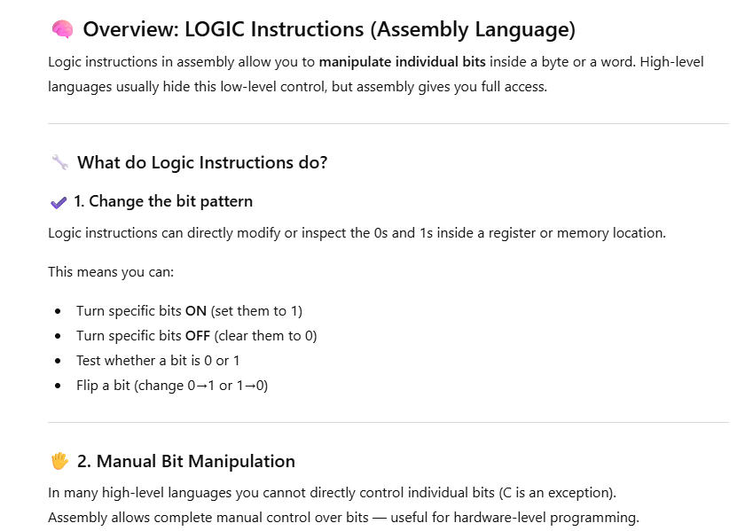

Slide 4
Overview: SHIFT
Bits can be shifted left or right in a register or memory location.
When a bit is shifted out, it goes into CF.
Because a left shift doubles a number and a right shift halves it, these instructions give us a way to multiply and divide powers of 2.
Shifting is much faster than Multiplication and Division.

Slide 5
LOGIC Instructions
The ability to manipulate individual bits is one the main advantages of assembly language.
Individual bits can be changed in computer by using logic operations.
The binary values of 0 = False and 1= True
When a logic operation is applied to 8- or 16-bit operands, the result is obtained by applying the logic operation at each bit position.

Slide 6
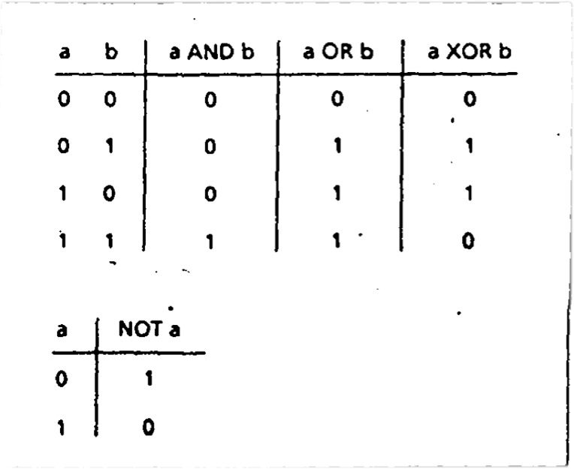
Truth Table for AND, OR, XOR and NOT

Slide 7
Solve the Following
AND Operation: 10101010 AND 11110000
OR Operation: 10101010 OR 11110000
XOR Operation: 10101010 XOR 11110000
NOT Operation: NOT 10101010

Slide 8
Solution
1
10101010
OR 11110000
=11111010
10101010
AND 11110000
=10100000
2
10101010
XOR 11110000
= 01011010
NOT 10101010
=01010101
3
4

Slide 9
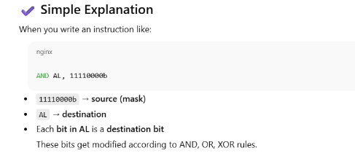
AND, OR, and XOR instructions
The AND, OR, and XOR instructions perform the named logic operations. The formats are:
The result of the operation is stored in the destination, which must be a register or memory location.
The source may be a constant, register, or memory location.
However, memory-to-memory operations are not allowed.
    AND destination, source
    OR destination, source
    XOR destination, source

Slide 10
Effect on Flags
  SF, ZF, PF reflect the result
  AF is undefined
  CF, OF= 0
One use of AND, OR, and XOR is to selectively modify the bits in the destination.
To do this, we construct a source bit pattern known as mask.
The mask bits are chosen so that the corresponding destination bits are modified in the desired manner when the instruction is executed.

Slide 11
MASK
To choose the mask bits, we make use of the following properties of AND, OR, and XOR:
b AND 1 = b
b OR 0 = b
b XOR 0 = b
b AND 0 =0
b OR 1 = 1
b XOR 1 = ~b (complement of b)

Slide 12
The AND instruction can be used to CLEAR specific destination bits while preserving the others.
  A 0 mask bit clears the corresponding destination bit.
  a 1 mask bit preserves the corresponding destination bit.
The OR instruction can be used to SET specific destination bits while preserving the others.
  A 1 mask bit sets the corresponding destination bit.
  A 0 mask bit preserves the corresponding destination bit. ·
The XOR instruction can be used to complement specific destination bits while preserving the others.
  A 1 mask bit complements the corresponding destination bit;
  A 0 mask bit preserves the corresponding destination bit.

Slide 13
Clear bit
Example
Clear the sign bit of AL while leaving the other bits unchanged
Solution:
  Use the AND instruction with 01111111b=7Fh as the mask.
  Thus. AND AL,7Fh

Slide 14
Set or Complement Bit
Example: Set the most significant and least significant bits of AL while preserving the other bits.
  Solution: Use the OR instruction with 10000001b =81h as the mask.
  Thus, OR AL,81h
Example: Change the sign bit of DX.
  Solution: Use the XOR instruction with a mask of 8000h.
  Thus, XOR DX,8000h
*** To avoid typing errors, it's best to express the mask in hex rather than binary, especially if the mask would be 16 bits long.

Slide 15
Converting an ASCII Digit to a Number
when program reads a character or digit from the keyboard, AL gets the ASCII code of the character.
For example, if the "5" key is pressed, AL gets 35h instead of 5. To get 5 in AL, we did
    SUB AL,30h
We can also do this by using an AND instructions to clear the high four bits of AL.
    AND AL,0Fh
As the ASCII codes of "0" to "9" are 30h to 39h, this method will convert any ASCII digit to a decimal value.
Using AND emphasizes on modifying bit pattern of AL and makes program more readable.
Problem: convert a stored decimal digit to Its ASCII code?

Slide 16
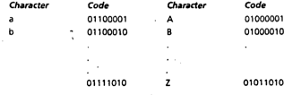
Converting a Lowercase Letter to Upper Case
The ASCII codes range for
  "a" to “z" is 61h to 7Ah
  "A" to "Z" is 41h to 5Ah.
So, to convert a lowercase to UPPERCASE we use the following operation:
  Sub DL,20h
However, if we compare binary codes of corresponding lower and uppercase letters,

Slide 17
Conversion using AND
To convert lower to upper case we need to clear only bit 5. This can be done by using an AND instruction with the mask 11011111 or 0DFh. So if the lowercase character to be converted is In DL, we execute
AND DL, 0DFh

Slide 18
Clearing a Register
MOV AX,0
SUB AX,AX
XOR AX,AX [1 XOR 1 = 0 and 0 XOR 0=0]
Testing a Register for Zero
To test the contents of a register for zero, or to check the sign of the contents, we may use:
CMP CX,0

Slide 19
Not Instruction
The NOT instruction performs the one's complement operation on the destination. The format is:
  NOT destination (**No effect on status flags)
  Example: Complement the bits in AX:
      NOT AX

Slide 20
TEST Instruction
The TEST Instruction performs an AND operation of the destination with the source but does not change the destination contents.
The purpose of the test instruction is to set the status flags. The format is:
    TEST destination, Source
Effects of flags on test operation:
  CF, OF =0
  AF = Undefined
  SF, ZF, PF reflect the result

Slide 21
Bit Examination on TEST
TEST instruction can be used to examine individual bits in operand.
The mask should contain 1's in the bit positions to be tested and 0’s elsewhere
    As 1 AND b = b, 0 AND b = 0
The operation TEST destination, mask
Will have 1's in the tested bit positions if and only if the destination has 1’s in these positions; and 0’s elsewhere.
if the destination has 0’s in all the tested positions, the result will be 0 and thus ZF=1

Slide 22
Find Even Number
Example: Jump to label BELOW If AL contains an even number.
Solution: Even numbers have a 0 in bit 0. Thus, the mask is 00000001b=1
      TEST AL, 1
      JZ BELOW

Slide 23
The shift and rotate instructions shift the bits in the destination operand by one or more positions either to the left or right.
For a shift instruction, the bits shifted out are lost
For a rotate instruction, bits shifted out from one end of the operand are put back into the other end.
The instruction have two possible formats. For a single shift or rotate, the form is
    Opcode destination,1
For a shift or rotate of N positions, the form is
    Opcode destination, CL
Where CL contains N In both cases, destination is an 8- or 16-bit register or memory location.

Slide 24
Shift Instructions…
Shift or Rotate instructions can be used to multiply and divide by powers of 2, and we will use them in programs for binary and hex I/O
***Note that for Intel's more advanced processors, a shift or rotate instruction also allows the use of an 8-bit constant.

Slide 25
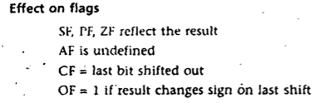
Left Shift (SHL) Instructions
The SHL (shift left) instruction shifts the bits in the destination to the left. The format for a single shift is
      SHL destination, 1
A 0 is shifted into the rightmost bit position and the msb is shifted into CF. If the shift count N is different from 1, the instruction takes the form
  SHL destination, CL (Here CL contains N and the above instruction made N single shifts)
    The value of CL remains the same after the shift operation

Slide 26
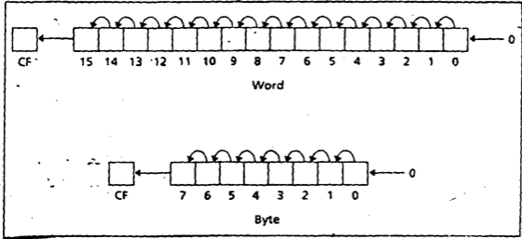
SHL Instruction
Example: Suppose DH contains 8Ah and CL contains 3. What are the values of DH and of CF after the instruction SHL DH,CL is executed?
The binary value of DH is 10001010. After 3 left shifts, CF will contain 0. The new contents of DH may be obtained by
Erasing the leftmost three bits
Adding three zero bits to the right end, thus 01010000b = 50h.

Slide 27
Multiplication by Left Shift
Let us consider a decimal number 235.
  If each digit is shifted left and 0 is attached on the right end, we get 2350 which is same as multiplying by 10.
  Similarly, a left shift on a binary number multiplies it by 2.
For example, suppose that AL contains 5=00000101b
  A left shift gives 00001010b = 10 thus doubling its value.
  Another left shift yields 00010100= 20d, so it is doubled again.

Slide 28
Shift Arithmetic Left (SAL)
SHL Instruction can be used to multiply an operand by multiples of 2.
However, to emphasize the arithmetic nature of the operation the opcode SAL (shift arithmetic left)often used in instances for numeric multiplication.
Both instructions generate the same machine code.
When we treat left shifts as multiplication, overflow may occur.
For a single left shift, CF and OF accurately indicate unsigned and signed over- flow, respectively.
However, the overflow flags are not reliable indicators for a multiple left shift as multiple shift is really a series of single shifts, and OF and CF only reflect the result of the last shift.

Slide 29
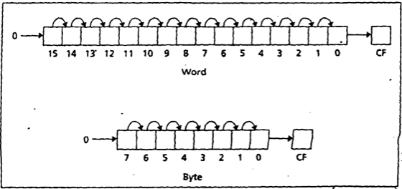
Right Shift (SHR) Instructions
The instruction SHR (shift right) performs right shifts on the destination operand
        SHR destination, 1
A 0 is shifted Into the msb position, and the rightmost bit is shifted
        SHR destination, CL
        ** here CL contains N In this case N single right shifts are made. The effect on the flags is the same as for SHL

Slide 30
Example SHR
Problem: Suppose DH contains 8Ah and CL contains 2. What are the values of DH and CF after the Instruction SHR DH,CL is executed?
Solution: The value of DH in binary is 10001010.
After two right shifts, CF=1
The new value of DH is obtained by erasing the rightmost two bits and adding two 0 bits to the left end, thus DH =00100010b = 22h.

Slide 31
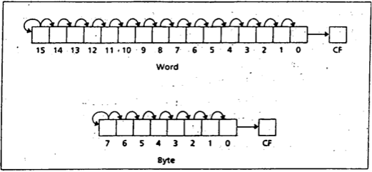
SAR Instruction
The SAR Instruction (shift arithmetic right) operates like SHR , with one difference: the msb retains Its original value. The syntax is:
SAR destination,1
SAR destination, CL

Slide 32
Division by Right Shift
A Left shift doubles the destination's value,
Similarly, it’s reasonable to guess that a right shift might divide it by 2. This Is correct for even numbers.
For odd numbers, a right shift halves it and rounds down to the nearest integer.
For example, if BL contains 00000101 = 5, then after a right shift. BL will contain 00000010 = 2

Slide 33
Signed and Unsigned Division
In case of division by right shifts, we need to make a distinction between signed and unsigned numbers.
If an unsigned interpretation is being given, SHR should be used.
For a signed interpretation, SAR must be used, because it preserves the sign.
Problem: Use right shifts to divide the unsigned number 65143 by 4. Put the quotient in AX
To divide by 4, two right shifts are needed. Since the dividend is unsigned, we use SHR. The code is
            MOV AX, 65143
            MOV CL, 2
            SHR AX,CL

Slide 34
SAR
Example: If AL contains -15, give the decimal value of AL after SAR AL,1 is performed.
Solution: Execution of SAR AL,1 divides the number by 2 and rounds down.
  Dividing -15 by 2 yields -7.5, and after rounding down we get -8.
  In terms of the binary contents, we have -15=11110001b. After shifting, we have 11111000b= -8.
  *** We will see some MUL and DIV for multiplication operations that are not limited to power of 2 only. However, MUL and DIV is much slower than SHIFT operation

Slide 35
References
Assembly Language Programming and Organization of the IBM PC, Ytha Yu and Charles Marut, McGraw Hill, 1992. (ISBN: 0-07-072692-2).
http://faculty.cs.niu.edu/~byrnes/csci360/notes/360shift.htm

Slide 36
Books
Assembly Language Programming and Organization of the IBM PC, Ytha Yu and Charles Marut, McGraw Hill, 1992. (ISBN: 0-07-072692-2).
Essentials of Computer Organization and Architecture, (Third Edition), Linda Null and Julia Lobur
W. Stallings, “Computer Organization and Architecture: Designing for performance”, 67h Edition, Prentice Hall of India, 2003, ISBN 81 – 203 – 2962 – 7
Computer Organization and Architecture by John P. Haynes.

